Slide 1
CSS
Indeed Inspiring Infotech

Slide 2

Level 1

Slide 3
CSS
Cascading Style Sheet
It is a language that is used to describe the style of a document.

Slide 4


Basic Syntax
Selector
h1 {
Color : red;
}
Property
Value

Slide 5
Including Style
Inline
<h1 style="color: red"> Apna College </h1>
<style> tag
<style>
h1 {
color : red;
}
</style>

Slide 6
Including Style
External Stylesheet
Writing CSS in a separate document & linking it with HTML file

Slide 7
Color Property
Used to set the color of foreground
color: red;
color: pink;
color: blue;
color: green;

Slide 8
Background Color Property
Used to set the color of background
background-color: red;
background-color: pink
background-color: blue;
background-color: green;

Slide 9
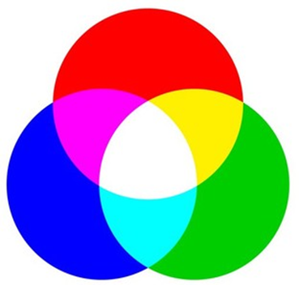
Color Systems
RGB
color: rgb(255, 0, 0);
color: rgb(0, 255, 0);

Slide 10
Color Systems
Hex (Hexadecimal)
color: #ff0000;
color: #00ff00;

Slide 11
Selectors
Universal Selector
* { }
Element Selector
h1 { }
Id Selector
#myId { }
Class Selector
.myClass { }

Slide 12
Practice Set 1
Q1: Create a simple div with an id "box".
Add some text content inside the div.
Set its background color to blue.
Q2: Create 3 headings with h1, h2 & h3.
Give them all a class "heading" & set color of "heading" to red.
Q3: Create a button & set its background color to :
green using css stylesheet
blue using <style> tag
pink using inline style

Slide 13
Text Properties
Text-align
text-align : left / right / center

Slide 14
Text Properties
Text-decoration
text-decoration : underline /overline/ line- through

Slide 15
Text Properties
Font-weight
font-weight : normal / bold / border / lighter
font-weight : 100-900

Slide 16
Text Properties
Font-family
font-family : arial, roboto

Slide 17
Units in CSS
Absolute
pixels (px)
96px = 1 inch
font-size: 2px;

Slide 18
Text Properties
Line-height
line-height : 2px
line-height : 3
line-height : normal

Slide 19
Text Properties
text-transform
text-tranform : uppercase / lowercase/ capitalize/ none

Slide 20
Practice Set 2
Q1: Create a heading centred on the page with all of its text capitalized by default.
Q2: Set the font family of all the content in the document to "Times New Roman".
Q3: Create one div inside another div.
Set id & text "outer" for the first one & "inner" for the second one.
Set the outer div text size to 25px & inner div text size to 10px.

Slide 22

Level 2

Slide 23
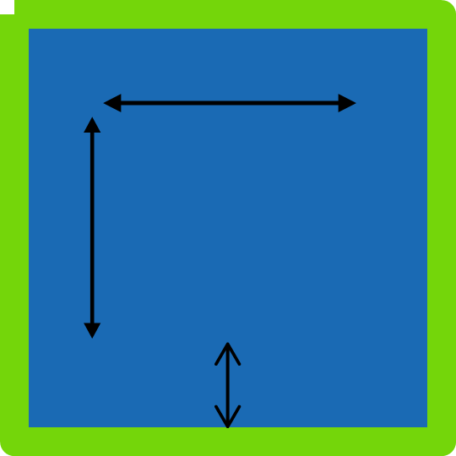

Box Model in CSS
height
Width
Height
Width
Border
Padding
Margin
Content
margin
padding
border

Slide 24
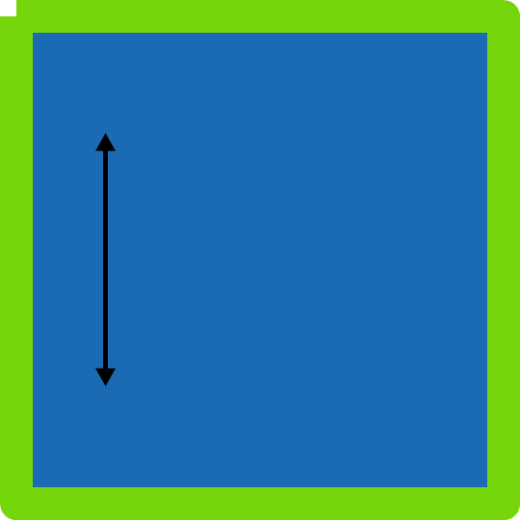
Height
By default, it sets the content area height of the element
div {
height: 50px;
}
Height
Content

Slide 25
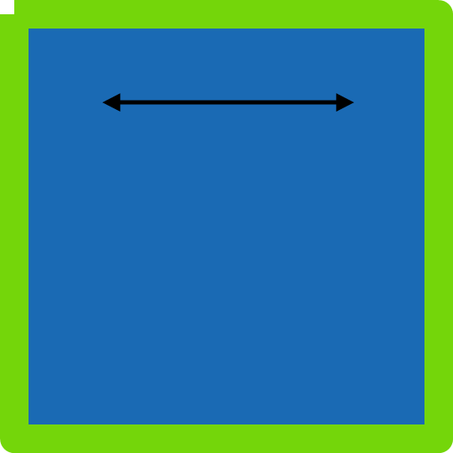
Width
By default, it sets the content area width of the element
div {
width: 50px;
}
Width
content

Slide 26

Border
Used to set an element's border
border-width : 2px;
border-style : solid / dotted / dashed
border-color : black;
content
border

Slide 27
Border
Shorthand
border : 2px solid black

Slide 28
Border
Used to round the corners of an element's outer border edge
border-radius : 10px;
border-radius : 50%;

Slide 29
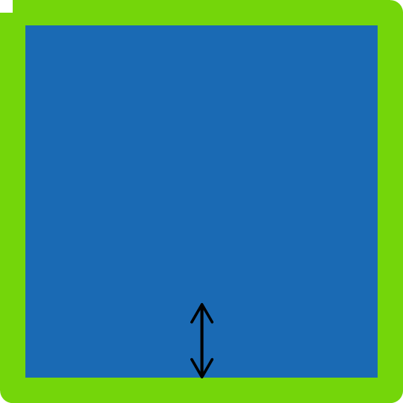
Padding
padding-left
padding-right
padding-top
padding-bottom
content
padding

Slide 30
Padding
Shorthand
padding: 50px;
padding: 1px 2px 3px 4px;
top | right | bottom | left -> clockwise

Slide 31

Margin
margin-right
margin-left
margin-top
margin-bottom
content
margin
Content

Slide 32
Margin
Shorthand
margin: 50px;
margin: 1px 2px 3px 4px;
top | right | bottom | left -> clockwise

Slide 33
Practice Set 3
Q1: Create a div with height & width of 100px.
Set its background color to green & the border radius to 50%.
Q2: Create the following navbar.

Slide 34
Display Property
display: inline / block / inline-block / none
inline - Takes only the space required by the element. (no margin/ padding)
inline-block - Similar to inline but we can set margin & padding.
block - Takes full space available in width
none - To remove element from document flow.

Slide 35
Visibility
visibility: hidden;
Note : When visibility is set to none, space for the element is reserved.
But for display set to none, no space is reserved or blocked for the element.

Slide 36
opacity (0 to 1)
RGBA
color: rgba(255, 0, 0, 0.5);
color: rgba(255, 0, 0, 1);

Slide 37
Practice Set 4
Q1: Create a web page layout with a header, a footer & a content area containing 3 divs.
Set the height & width of divs to 100px.
(add the previous navbar in the header)
Q2: Add borders to all the divs.
Q3: Add a different background color to each div with an opacity of 0.5
Q4: Give the content area an appropriate height.

Slide 38

Level 3

Slide 39
Units in CSS
Relative
%
em
rem

Slide 40
Percentage (%)
It is often used to define a size as relative to an element's parent object.
width : 33% ;
margin-left : 50% ;

Slide 41
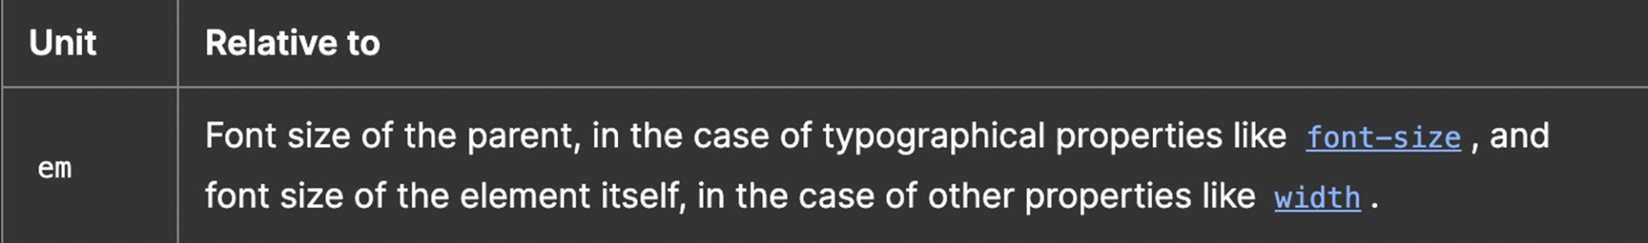
Em

Slide 42
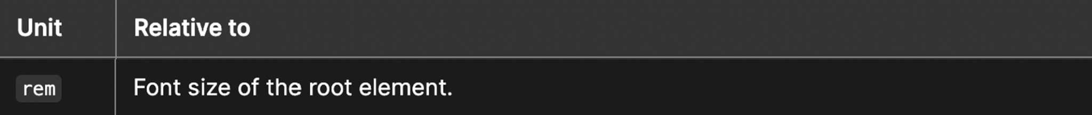
Rem (Root Em)

Slide 43
Others
vh: relative to 1% viewport height
vw : relative to 1% viewport width

Slide 44
Position
The position CSS property sets how an element is positioned in a document.
position : static / relative /absolute / fixed

Slide 45
Position
static - default position (The top, right, bottom, left, and z-index properties have no effect)
relative - element is relative to itself. (The top, right, bottom, left, and z-index will work)
absolute - positioned relative to its closest positioned ancestor. (removed from the flow)
fixed - positioned relative to browser. (removed from flow)
sticky - positioned based on user's scroll position

Slide 46
z-index
It decides the stack level of elements
Overlapping elements with a larger z-index cover those with a smaller one.
z-index : auto (0)
z-index : 1 / 2 / ...
z-index : -1 / -2 / ...

Slide 47
Background Image
Used to set an image as background
background-image :url("image.jpeg");

Slide 48
Background Size
background-size : cover / contain / auto

Slide 49
Practice Set 5
Qs: Create the following layout using the given html.
Give the div a height, width & some background image.
Use the appropriate position property for the div element to place it at the
right end of the page. (The div should not move even on scroll)
Use z-index to place the div on top of page.
<p> lorem*5 </p>
<div> Love Nature </div>
<p> lorem*5 </p>

Slide 50

Level 4

Slide 51
Flexbox
Flexible Box Layout
It is a one-dimensional layout method for arranging items in rows or columns.

Slide 52
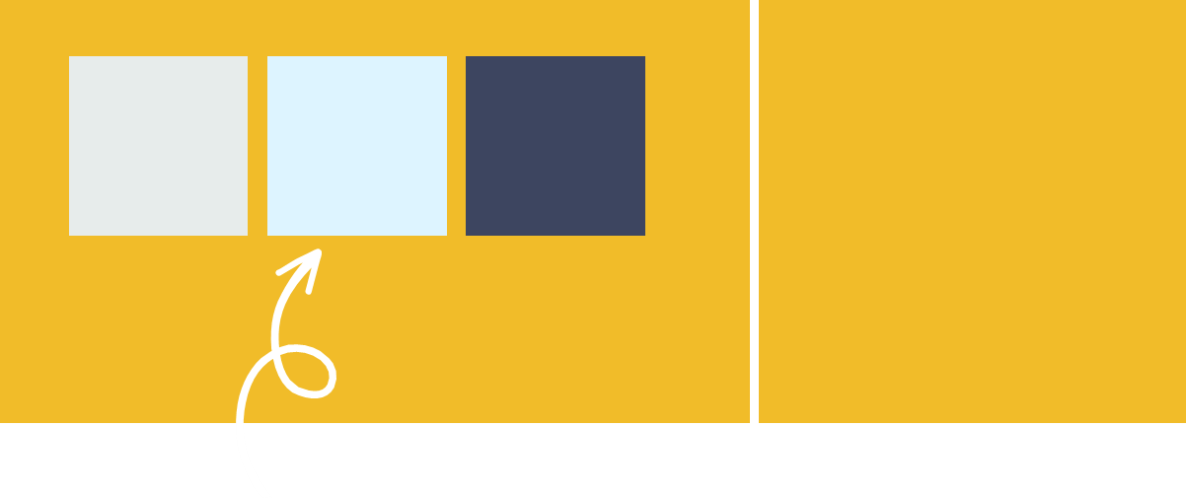
The Flex Model
Main Axis
flex item
Cross axis

Slide 53
Flexbox Direction
It sets how flex items are placed in the flex container, along which axis and direction.
flex-direction : row; (default)
flex-direction : row-reverse;
flex-direction : column;
flex-direction : column-reverse;

Slide 54
Flex Properties
for Flex Container
justify-content : alignment along the main axis.
flex-start / flex-end / centre / spac
flex-wrap : nowrap / wrap/ wrap reverse
align-items : alignment along the cross axis.
align-content : alignment of space between & around the content along cross-axis

Slide 55
Flex Properties
for Flex Item
align-self : alignment of individual along the cross axis.
flex-grow : how much a flex item will grow relative to the rest of the flex items if space is available
Flex-shrink : how much a flex item will shrink relative to the rest of the flex items if space is available

Slide 56
Practice Set 6
Qs: Create a navbar with 4 options in the form of anchor tags inside list items.
Now, use flexbox to place them all spaced equally in a single line.
Qs: Use flexbox to center one div inside another div.
Qs: Which has higher priority - align-items or align-self?

Slide 57
Media Queries
Help create a responsive website
@media (width : 600px) {
div {
background-color : red;
}
}
@media (min-width : 600px) {
div {
background-color : red;
}
}

Slide 58
Media Queries
@media (min-width : 200px) and (min-width : 300px) {
div {
background-color : red;
}
}

Slide 59
Practice Set 7
Qs: Add a media query to implement the following:
the color of a div changes to green for viewport width less than 300px
the color of a div changes to red for width between 300px & 400px
the color of a div changes to red for width between 400px & 600px
the color of a div changes to blue for width above 600px

Slide 60

Level 5

Slide 61
Transitions
Transitions enable you to define the transition between two states of an element.
transition-property : property you want to transition (font-size, width etc.)
transition-timing-function: ease-in / ease-out/ linear /steps ..
transition-delay : 2s / 4ms ..

Slide 62
Transition Shorthand
property name | duration | timing-function | delay
transition: font-size 2s ease-in-out 0.2s;

Slide 63
CSS Transform
Used to apply 2D & 3D transformations to an element
rotate
transform: rotate(45deg);

Slide 64
CSS Transform
Scale
transform: scale(2);
transform: scale(0.5);
transform: scale(1, 2);
transform: scaleX(0.5);
transform: scaleY(0.5);

Slide 65
CSS Transform
translate
transform: translate(20px);
transform: translate(20px, 50px);
transform: translateX(20px);
transform: translateY(20px);

Slide 66
CSS Transform
Skew
transform: skew (30deg);

Slide 67
Animation
To animate CSS elements
@keyframe myName {
from { font-size : 20px; }
to { font-size : 40px; }
}

Slide 68
Animation Properties
animation-name
animation-duration
animation-timing-function
animation-delay
animation-iteration-count
animation-direction

Slide 69
animation-direction
animation : myName 2s linear 3s infinite normal

Slide 70
% in Animation
@keyframe myName {
0% { font-size : 20px; }
50% { font-size : 30px; }
100% { font-size : 40px; }
}

Slide 71
Practice Set 8
Qs: Create a simple loader using CSS
Step1 : create a div with circular shape & a thick border from one end
(top/bottom/left/right)
Step2 : To make it spin create an animation which transforms it from 0 deg to 360deg
Step3 : Add the animation property to the loader with infinite duration

